Slide 1

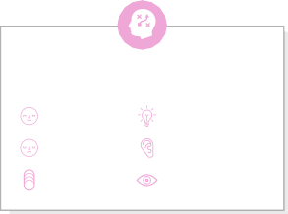




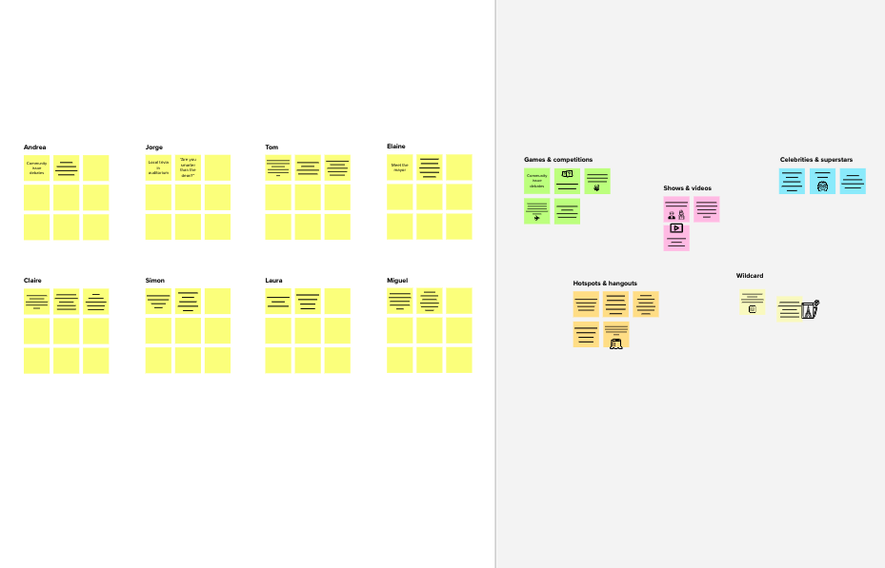




Template
2
Brainstorm
Write down any ideas that come to mind that address your problem statement.
10 minutes
Before you collaborate
A little bit of preparation goes a long way with this session. Here’s what you need to do to get going.
10 minutes
1
Define your problem statement
What problem are you trying to solve? Frame your problem as a How Might We statement. This will be the focus of your brainstorm.
3
Group ideas
Take turns sharing your ideas while clustering similar or related notes as you go. In the last 10 minutes, give each cluster a sentence-like label. If a cluster is bigger than six sticky notes, try and see if you and break it up into smaller sub-groups.
4
Prioritize
Your team should all be on the same page about what's important moving forward. Place your ideas on this grid to determine which ideas are important and which are feasible.
After you collaborate
You can export the mural as an image or pdf to share with members of your company who might find it helpful.
TIP
You can select a sticky note and hit the pencil [switch to sketch] icon to start drawing!
TIP
Add customizable tags to sticky notes to make it easier to find, browse, organize, and categorize important ideas as themes within your mural.
5 minutes
20 minutes
20 minutes
Brainstorm
& idea prioritization
Use this template in your own brainstorming sessions so your team can unleash their imagination and start shaping concepts even if you're not sitting in the same room.
_{A} Team gathering
Define who should participate in the session and send an invite. Share relevant information or pre-work ahead.
PROBLEM
Recognize the digits written by the users
Mohamed afsal
Babu
Quick add-ons
A feature to export the recognized text
Remove noises to improve the accuracy
Use image or canva as input
Digits like 3-8 , 1-7
should be trained more
Train Datasets
Input
_{A} Share the mural
Share a view link to the mural with stakeholders to keep them in the loop about the outcomes of the session.
Set the goal
Dataset should contain the digits of varying styles
Train different Styles of handwriting
User friendly interface
Can be tried both in offline and online
Output as Digital Text,Txt file,PDF,image file
B
Think about the problem you'll be focusing on solving in the brainstorming session.
Various algorithms can be used
Scan using mobile phone
Scanner can be used to scan the handwritten documents
Dataset should contain the digits of varying styles
Use image or canva as a input
Scan using mobile phone
B Export the mural
Export a copy of the mural as a PNG or PDF to attach to emails, include in slides, or save in your drive.
_{C} Learn how to use the facilitation tools
Use the Facilitation Superpowers to run a happy and productive session.
10 minutes to prepare
1 hour to collaborate
2-8 people recommended
Open article
Mujibur Rahman
Digits like 3-8 , 1-7
should be trained more
Scanner can be used to scan the handwritten documents
Keep moving forward
Suresh Kumar
Give input
Strategy blueprint
Define the components of a new idea or strategy.
Open the template
CNN can be used as a model for recognition
High quality images should be used for training
Segmentation techniques can also be used for recognizing the string of digits
Feedback from the users can be used for improving the model performance
from various
Alert user if any digit cannot be recognized
,ex:user inputs scribbling
ways:using
Key rules of brainstorming
To run an smooth and productive session
canvas,Real
Time,Photo
Customer experience journey map
Understand customer needs, motivations, and obstacles for an experience.
Open the template
Stay in topic.
Encourage wild ideas.
Use more images for training
Train different styles of handwriting
Alert user if any digit cannot be scanned
Test with
Various algorithms are used for
recognize and improve the accuracy of prediction
Defer judgment.
Listen to others.
different styles of
Importance
If each of these tasks could get done without any difficulty or cost, which would have the most positive impact?
handwriting
Strengths, weaknesses, opportunities & threats
Identify strengths, weaknesses, opportunities, and threats (SWOT) to develop a plan.
Open the template
Go for volume.
If possible, be visual.
Preprocessing
Remove noises to improve the accuracy
Segmentation techniques can also be used for recognizing the string of digits
Share template feedback
Scanner can be used to scan the handwritten documents
TIP
Participants can use their cursors to point at where sticky notes should go on the grid. The facilitator can confirm the spot by using the laser pointer holding the H key on the keyboard.
Share template feedback
Feasibility
Regardless of their importance, which tasks are more feasible than others? (Cost, time, effort, complexity, etc.)
Need some inspiration?
See a finished version of this template to kickstart your work.
Open example

